Slide 1
lemon

Slide 2
beans

Slide 3
mango

Slide 4
butter

Slide 5
coconut

Slide 6
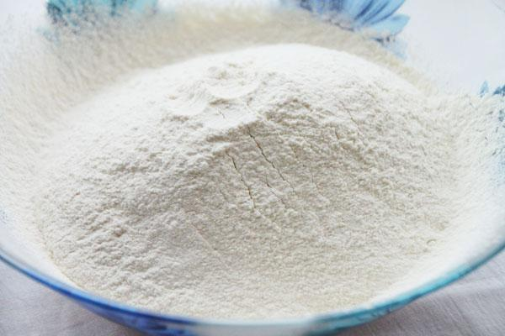
flour

Slide 7
pineapple

Slide 8
olive oil

Slide 9
sugar

Slide 10
salt and pepper

Slide 11
tomato

